Slide 1
ENERGY CONSUMPTION AND PREDICTION:
Kolluri siri pavan

Slide 2
Contents:
Project Objective and Overview | The project aims to analyze household energy consumption patterns and forecast future demand using data exploration, visualization, and predictive modeling.
Milestone 1 | Basic Data Exploration
Milestone 2 | Data Visualization and Encoding
Milestone 3 | Model Creation and Comparison
Milestone 4 | Time Series Forecasting With ARIMA And Prophet
Model Evaluation | Model evaluation using metrics to assess accuracy and performance of predictive models
Conclusion | Summarizing Insights and Recommendations For Optimizing Household Energy Consumption.

Slide 3
Dataset:
Household Power Consumption File
(Drive Link): https://drive.google.com/file/d/1Ed2J_M6piMDaPew780mORke29Do5-YQ3/view?usp=sharing

Slide 4
Project Objective:
The main aim of this project is to analyze household energy consumption data to:
Identify patterns in energy usage and variations over time and across appliances.
Determine peak usage periods to understand when energy demand is highest.
Address data challenges, such as missing values and fluctuations, for accurate insights.
Predict future energy requirements using advanced time-series forecasting models.
Develop actionable recommendations to optimize household energy consumption and enhance efficiency.

Slide 5
Project Overview:
The project focuses on analyzing household energy usage using a dataset containing minute-level data on power consumption, voltage, current intensity, and appliance-specific usage.
Key Milestones:
Data Exploration: Investigated dataset structure and addressed missing values.
Visualization & Feature Encoding: Analyzed trends and incorporated time-based features.
Model Development: Built regression models to evaluate energy consumption patterns.
Forecasting: Predicted future energy consumption using ARIMA and Prophet models.
Outcome:
Provided valuable insights into energy consumption patterns and developed models for accurate forecasting.

Slide 6
Milestone 1:
02
(BASIC DATA EXPLORATION)

Slide 7
Dataset Description:
Key Features:
Global Active Power: Total energy consumed in active power.
Global Reactive Power: Energy required to sustain electric and magnetic fields.
Voltage: Voltage of the household power supply.
Global Intensity: Combined current intensity of the household.
Sub-metering 1, 2, 3: Energy consumption by lighting systems, HVAC (heating, ventilation, and air conditioning), and kitchen appliances.
Dataset Size:
Rows: 1,200,000
Columns: 7

Slide 8
Initial Data Analysis:
Displays the first 5 rows of the dataset, giving an overview of its structure and variables.
df.shape: Indicates the dataset dimensions, with over 2 million rows and 9 columns, providing insights into its size.
df.info(): Summarizes the dataset, revealing that most features are of type 'object' except for 'Sub_metering_3,' which is numeric.
These functions are crucial for understanding the dataset:
df.head(): Provides a snapshot of the data structure and content.
df.shape: Helps assess the dataset's size by showing its number of rows and columns.
df.info(): Highlights data types, the count of non-null values, and potential areas requiring type conversions or cleaning.

Slide 9
Analysis and Handling of Missing Data :
Missing data was detected and managed through various approaches. For columns with missing values, gaps were filled using default values like zero, the mean, or the median of the respective columns. In some cases, rows with missing data were removed to maintain the dataset's cleanliness and accuracy. These actions were crucial in preparing the data for more in-depth analysis and model development.

Slide 10
Data Visualization and Key Insights :
Visualizations such as histograms and boxplots were used to analyze power consumption, while a correlation heatmap helped identify relationships between features. Time-based features were added by converting 'Date' and 'Time' to datetime format and extracting hour, day, and month for deeper analysis.
The dataset was thoroughly explored. It was found that 'Sub_metering_3' had the most missing values, which were addressed by filling them with the mean, median, or zero. Several strategies were applied to handle missing data, leading to a cleaner dataset.Recommendations include utilizing time-series models with the new datetime features for more accurate forecasting, as well as further cleaning to eliminate outliers and noise for better prediction accuracy.

Slide 11
Analysis:
Functions | Use case | Observations
df.head() | Displays the first 5 rows of the dataset to preview its structure and values. | We can see the first 5 rows of our dataset
df.tail() | Displays the last 5 rows of the dataset to inspect the end of the data. | We can see the last 5 rows of our dataset
df.shape | Returns the number of rows and columns in the dataset. | The number of rows and columns are displayed(2075259, 9)
df.info() | Provides a summary of the dataset, including data types and non-null counts. | We can see that only sub_metering3 is of float type all others are object type.
df.describe() | Generates summary statistics (mean, std, min, max, etc.) for numeric columns. | The respective values are displayed
df.isnull().sum() | Identifies the number of missing values in each column. | Sub_metering3 has 25979 null values
df.fillna(0) | Fill the null value with 0’s. | After filling it shows some rows of our data.
df.fillna(df['Sub_metering_3'].mean()) | Fills the null values with the mean of the column. | After filling with the mean it outputs some sample of data.
df.fillna(df['Sub_metering_3'].median()) | Fills the null values with the median of the column. | After filling with the median it outputs some sample of data.
df.unique() | Lists the unique values in a column. | It displays number of unique values in each column

Slide 12
Milestone 2:
03
(DATA VISUALISATION AND ENCODING)

Slide 13
Process:
Objective: Preprocess the dataset for power consumption forecasting
Key Steps:
To identify missing values and non-numeric data.
Addressing missing values by converting non-numeric entries to NaN and filling missing data with 0.
Outcome:
We will achieve a cleaned dataset with no missing and null values .It will be prepared for further analysis and feature engineering.

Slide 14
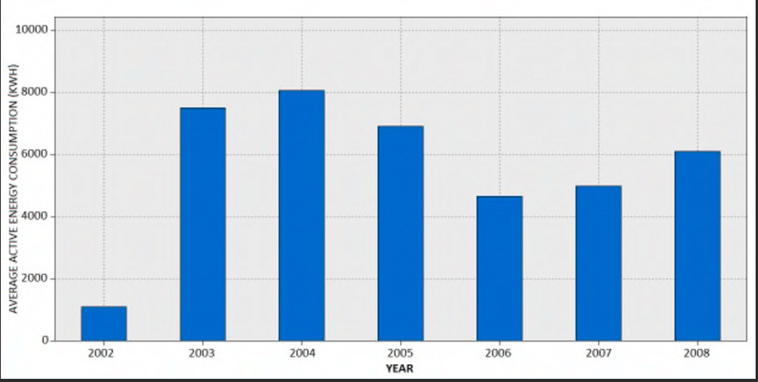
Average Active consumption over years:
Objective: Active consumption for a Given Year
Approach:
Added a 'year' column to the dataset, where:
Key Findings:
Current dataset only contains records labeled as column for year.
The average active energy consumption on rows.
Next Steps:
Collect and incorporate non-holiday data point

Slide 15
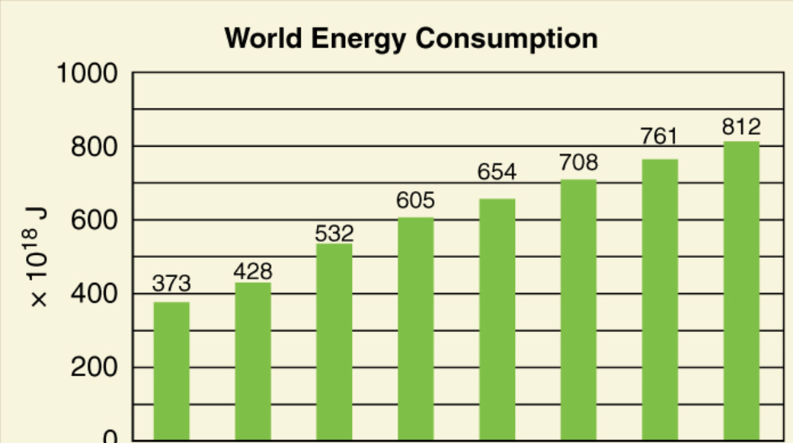
Feature Engineering - Sunlight:
Objective: Determine Daylight Status for Each Record
Approach:
Developed a function, is_light(hour), to assess whether a given hour falls within daylight hours (6:00 AM to 6:00 PM).
Added a 'Light' column indicating daylight status:
1 for daylight hours.
0 for non-daylight hours.
Outcome:
All records in the dataset fall within daylight hours, resulting in the 'Light' column being uniformly set to 1.

Slide 16
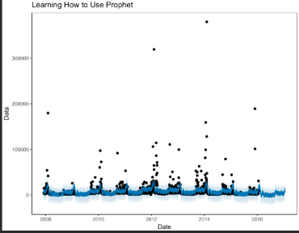
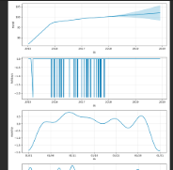
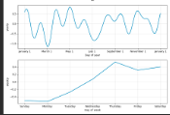
Plots:

Slide 17
Graphical Insights into Power Consumption:
Global Active Power Over Year
Visualization: Bar plot of Global_active_power against Year.
Insight: The Global_active_power is maximum in year 2009
Voltage vs. Global Active Power
Visualization: Scatter plot comparing Voltage and Global_active_power.
Insight: A strong positive correlation suggests that higher intensity corresponds to greater power consumption.
Density value for Voltage
Visualization: Kdeplot of Voltage values.
Insight: Voltage peak density is 0.12

Slide 18
Graphical Insights into Power Consumption:
Meter reading and which meter is used the most
Visualization: Pie chart of Sub_metering_1,Sub_metering_2,Sub_metering_3.
Insights: Based on the meters reading Sub_metering_3 is having high reading and Sub_meter 3 is used more than the other 2 Sub_meters.
Global Active Power vs. Global Reactive Power
Visualization: Scatter plot comparing Global_active_power and Global_reactive_power.
Insights: Global_active_power and Global_reactive_power are strongly correlated, which means that when one is high, the other is also likely to be high.
Voltage vs. Global Intensity
Visualization: Scatter plot comparing Voltage and Global_intensity.
Insights: Voltage and Global_intensiy seems to be a positive correlation between them. This is likely because higher voltage leads to higher current

Slide 19
Analysis and Recommendations:
Average Power Consumption Analysis
Average active power consumption:
Visualization: Bar plot showing average active power consumption for years.
Insight: Power consumption is noticeably higher on particular years.
Years:
Visualization: Bar plot depicting average active power during particular years.
Insight: Peak power consumption occurs during 2004.

Slide 20
Analysis and Recommendations:
Conclusions and Recommendations
Summary:
Addressed data gaps and standardized data types for consistency.
Created new features such as 'Average active power consumption', 'Year'.
Recommendations:
Conduct a detailed exploration of year-based power usage patterns leveraging the engineered features.
Employ year-series models to forecast future power consumption trends.
Identify and address outliers to enhance prediction accuracy and reliability.

Slide 21
Milestone 3:
04
(MODEL CREATION AND COMPARISON)

Slide 22
Regression Models Overview:
Linear Regression
Linear Regression fits a straight line to the data by minimizing the error between predicted and actual values. It works well for data with strong linear relationships but struggles with overfitting. Use it for simple, interpretable models without regularization.
Lasso Regression
Lasso Regression adds a penalty to shrink coefficients, with some becoming zero, effectively performing feature selection. It reduces model complexity and is useful for identifying the most important predictors. However, it may sacrifice some accuracy compared to Ridge or Linear Regression.
Ridge Regression
Ridge Regression penalizes the square of coefficients, shrinking them toward zero but retaining all features. It prevents overfitting and is effective for datasets with multicollinearity. Use it for a balance between accuracy and complexity when all features are relevant.

Slide 23
Training and Testing:
The data is split into training (80%) and testing (20%) sets to evaluate model performance. The models (Linear, Lasso, and Ridge Regression) are trained on the training set and then tested on the unseen testing set to check generalization ability. Metrics like Mean Squared Error (MSE) are used for evaluation.
Who performs better:
Ridge Regression usually performs better in complex datasets with many correlated features because it regularizes without eliminating any variables.
Lasso Regression works well if feature selection is needed, but can sometimes lose accuracy by removing too many features.
Linear Regression is simpler but may overfit with noisy or complex data, often outperformed by Ridge and Lasso.

Slide 24
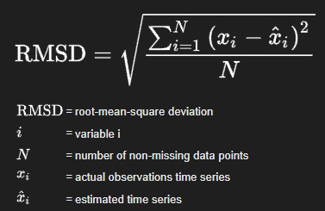

Performance Metrics:
Root Mean Squared Error (RMSE)
Definition: Measures the average magnitude of the prediction error. It gives an idea of how much error is in the model’s predictions. The lower the RMSE, the better the model.
Use Case: Used to evaluate the accuracy of regression models by measuring the difference between predicted and actual values.
R² Score
Definition: Measures how well the model explains the variance in the data. A score of 1 indicates perfect fit, while 0 indicates no explanatory power.
Use Case: Used to determine the goodness of fit for regression models.

Slide 25
Milestone 4:
05
(TIME SERIES FORECASTING WITH ARIMA
AND PROPHET MODELS)

Slide 26
Introduction to Time Series Forecasting:
Time series forecasting is used to predict future values based on past observations.
Common applications: sales predictions, stock prices, energy consumption.
In this presentation, we will forecast energy consumption using two popular models: ARIMA and Prophet.

Slide 27
ARIMA Model:
(AutoRegressive Integrated Moving Average)
ARIMA is a widely used statistical model for time series forecasting.
It combines:
AR (Auto-Regressive): The relationship between an observation and a number of lagged observations.
I (Integrated): Differencing the series to make it stationary.
MA (Moving Average): The relationship between an observation and a residual error from a moving average model.
ARIMA is used when data shows trends but not seasonal patterns.
ARIMA is used in finance, retail, healthcare, weather forecasting, transportation, energy, agriculture, telecommunications, and manufacturing for predicting trends, sales, stock prices, demand, traffic, and resource management based on historical data.

Slide 28
Steps to Implement ARIMA:
1.Data Preprocessing:
Load dataset, clean data, and handle missing values.
2.Splitting Data:
Split data into training and testing sets.
3.Model Creation:
Fit ARIMA model with selected order (p, d, q).
4.Model Evaluation:
Calculate performance metrics like RMSE to assess prediction accuracy.

Slide 29
Prophet Model:
Prophet is a forecasting tool designed to handle time series with daily observations that display patterns on different time scales.
Advantages:
Handles missing data well.
Can model holidays and seasonality.
Does not require stationarity of the data.
The Prophet model is used in forecasting demand, sales, website traffic, energy consumption, financial trends, and inventory management, as well as predicting seasonal patterns in various industries like retail and logistics.

Slide 30
Steps to Implement Prophet:
Data Preprocessing:
Convert the dataset into the format that Prophet requires.
Model Creation:
Fit Prophet model on training data.
Forecasting:
Predict future data points.
Model Evaluation:
Evaluate the forecast accuracy using RMSE or other metrics.

Slide 31
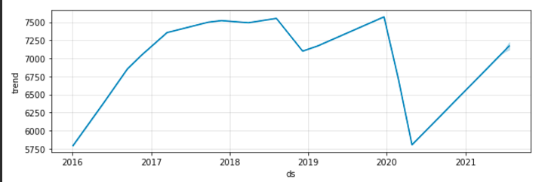
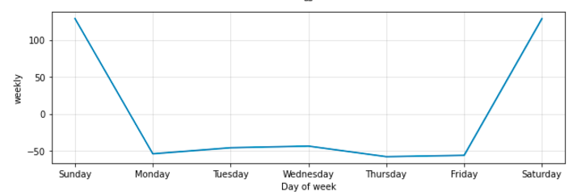
Component Analysis from Prophet Model:

Slide 32
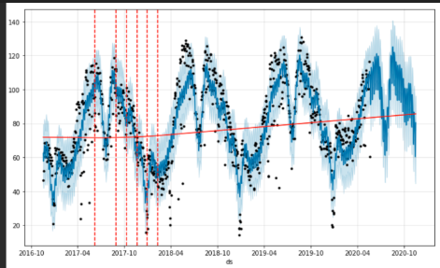
Plots from Prophet Model:

Slide 33
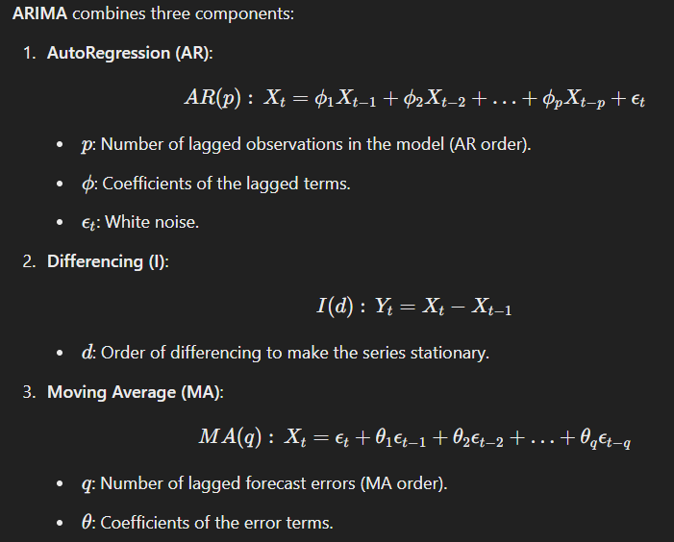
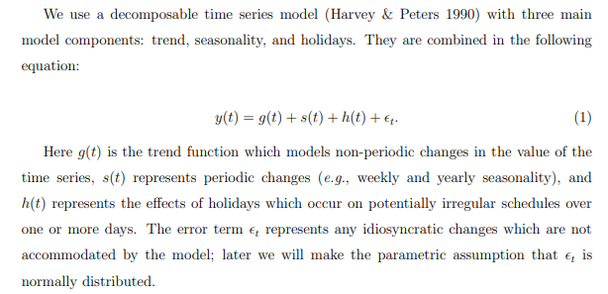
Mathematical Skeleton of the Models:
Prophet Model:
For More Info:
https://peerj.com/preprints/3190.pdf#pdfjs.action=download
https://people.duke.edu/~rnau/Mathematical_structure_of_ARIMA_models--Robert_Nau.pdf

Slide 34
Model Evaluation:
06

Slide 35


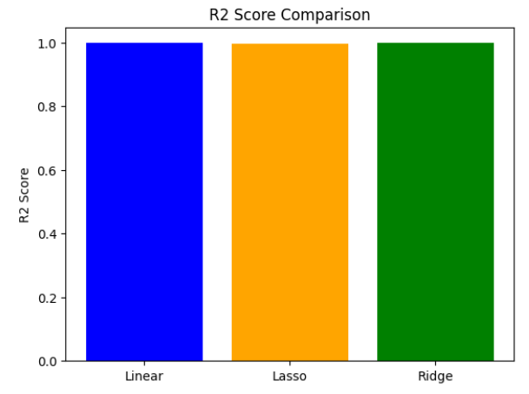
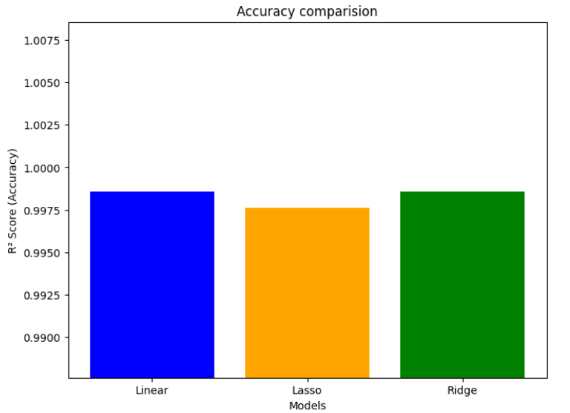
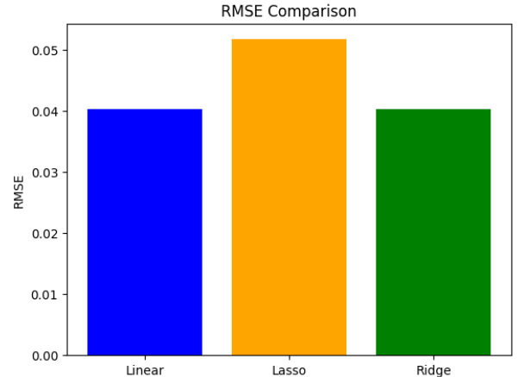
Regression Models:
Outputs:

Slide 36
Insights (Regression Models):
Linear and Ridge Regression perform equally well with high R² and low RMSE.
Lasso Regression sacrifices some accuracy for simplicity by shrinking some coefficients to zero.
RMSE Comparison: This shows that Lasso has the highest RMSE, indicating a slightly higher prediction error.
R² Score Comparison: Linear and Ridge Regression have nearly identical R² scores, indicating they explain the variance in the data similarly.
Summary:
Linear and Ridge are the most effective models for this dataset, with similar performance.
Lasso provides a more simplified model by shrinking some coefficients but sacrifices a slight bit of accuracy in doing so.

Slide 37
Results and Comparison (ARIMA and Prophet):
The ARIMA model (Order: 5,1,0) was evaluated using RMSE to predict energy consumption, revealing key patterns. The Prophet model, designed for seasonal time series, was compared to ARIMA, highlighting seasonal trends and holidays. Both models' forecast accuracy, including RMSE, was assessed through visual plots of forecasted vs. actual data.
ARIMA:
Best for stationary data.
Requires careful parameter selection (p, d, q).
Does not handle holidays or special events well.
Prophet:
Handles holidays and seasonal trends effectively.
Less sensitive to parameter tuning.
Works well with missing data.

Slide 38
Conclusion:
07
GITHUB: https://github.com/gnananawin/Energy-consumption-and-Prediction.git

Slide 39
This project was carried out in four key milestones.
In Milestone 1, we conducted an initial exploration of the dataset to gain valuable
insights. Milestone 2 involved visualizing data trends and performing feature
engineering to prepare the dataset for modeling. In Milestone 3, we applied
regression models to forecast energy consumption. Finally, in Milestone 4, we
utilized ARIMA and Prophet models for time series forecasting, evaluating their
accuracy in predicting future energy usage. Each milestone built on the previous
one, deepening our understanding and improving prediction accuracy, resulting in
a thorough analysis of energy consumption trends.

Slide 40


